Slide 1
Enhancement – Color View and UI by Issue Status

Slide 2
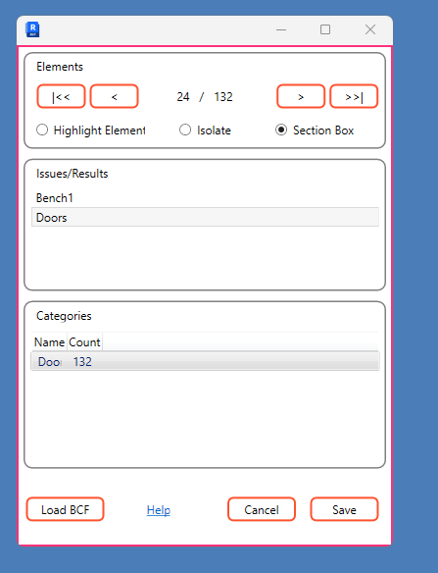
Color Text of issue based on Status and Add Family and Type; Color as well
Family:Type
24/
Add Counts for Issues, Ignore or Not Addressed,
Allow selection of the column to filter the Element list above
Issue
Ignore
Not Addressed
9
12
111

Slide 3
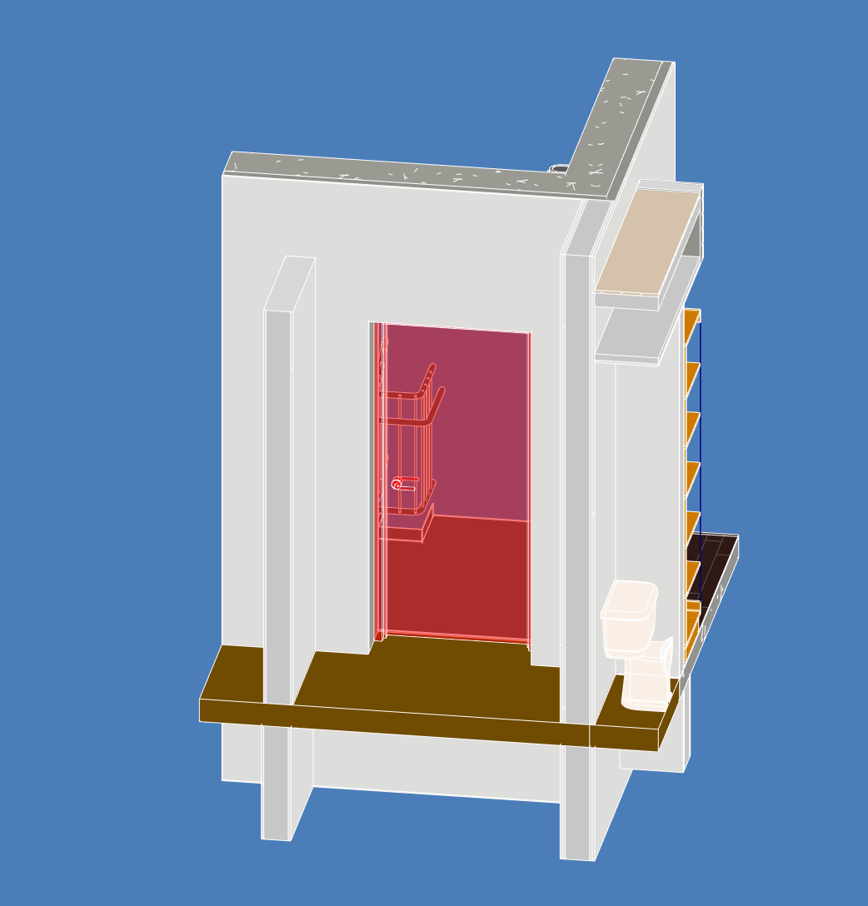

Slide 4
